Slide 1
the impact of music on teenagers' lifestyle

Slide 2
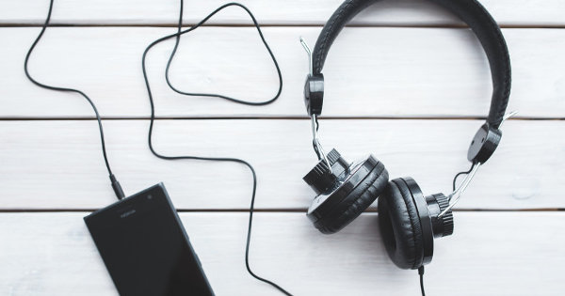
different kinds of music
different people;
different passions;
different free time management;
different music interests

Slide 3
We are all different. Our interests regarding the types of music we listen to are also subject to change.
This presentation should bring us all the differences between people and different preferences regarding listening to music.
I invite you to watch ;)

Slide 4
Rap
The Rap listeners are distinguished by the style of dress and speech. Often these are people who try to forget about the terrible experiences or sorrows they have been afflicted with. It is a group of people who identify themselves with the words of a given song, which contains a message that is an experience of the listener. Clothes that distinguish a person who likes to listen to rap are: loose tracksuits, sweatshirt, cap or pendant element around the neck.

Slide 5
Rap
Clothes that distinguish a person who likes to listen to rap are: loose tracksuits, sweatshirt, cap or pendant element around the neck.

Slide 6
Pop
I have never met a person who listens to pop and is sad and numb. They always radiate energy.

Slide 7
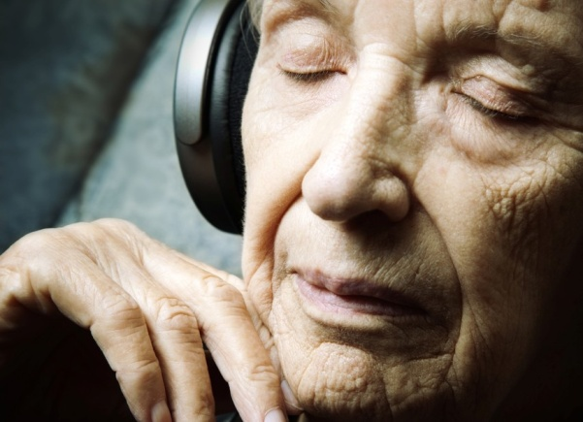
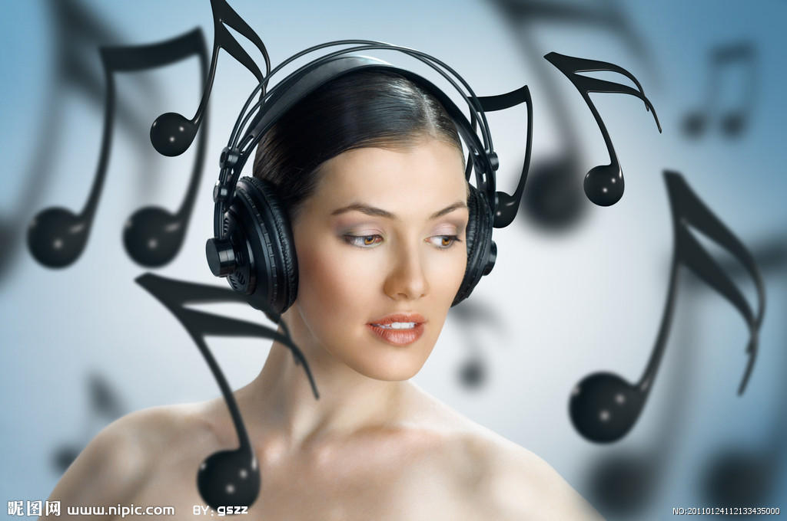
Classical
The pupils I know (listening to classical music) are people who are mastered. They often read books and have unique / unusual interests.

Slide 8
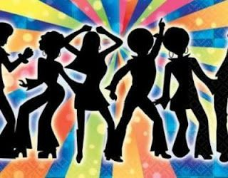
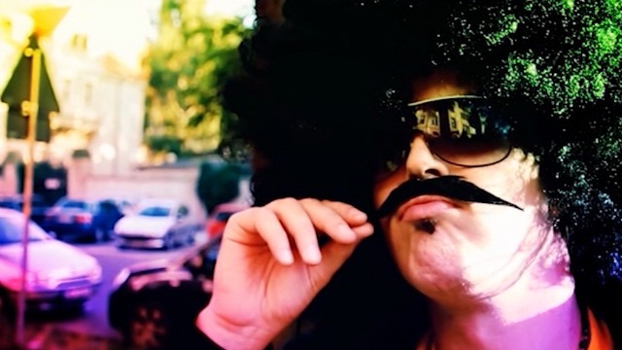
Disco polo
People who listen to disco polo are mostly smiling people. They are crazy dancers and greatly improve the mood of others. They are positively spun.

Slide 9
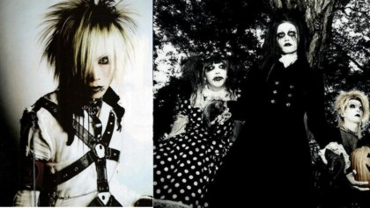
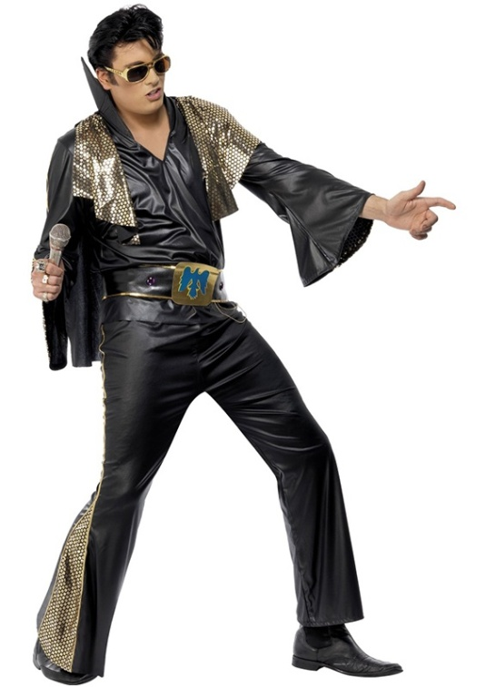
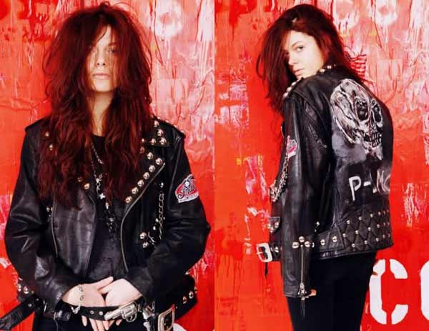
Rock
People listening to rock are usually characterized by the fact that they are black pants, sneakers, sneakers, shirts and sweatshirts in various shades of gray and black or with the logo of your favorite band.

Slide 10
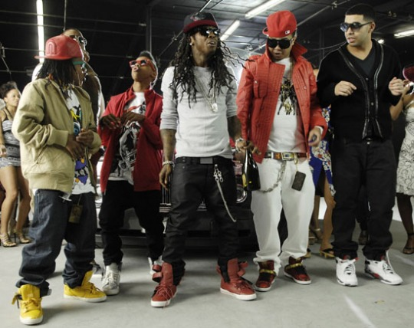
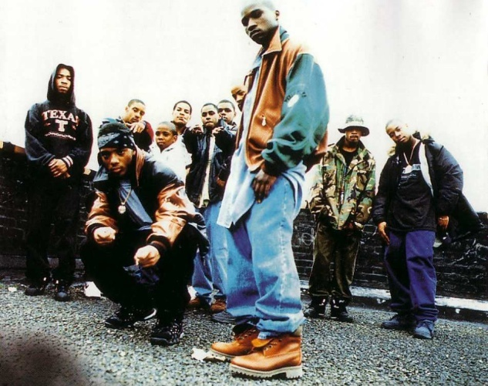
Hip-Hop
For those listening to hip-hop, the most important is a relaxed and casual lifestyle, loose clothing, large hooded sweatshirts and low-legged trousers.

Slide 11
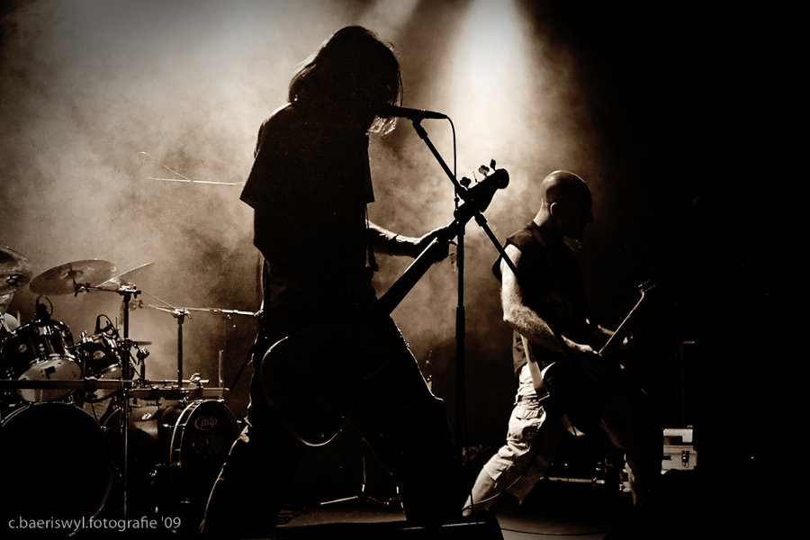
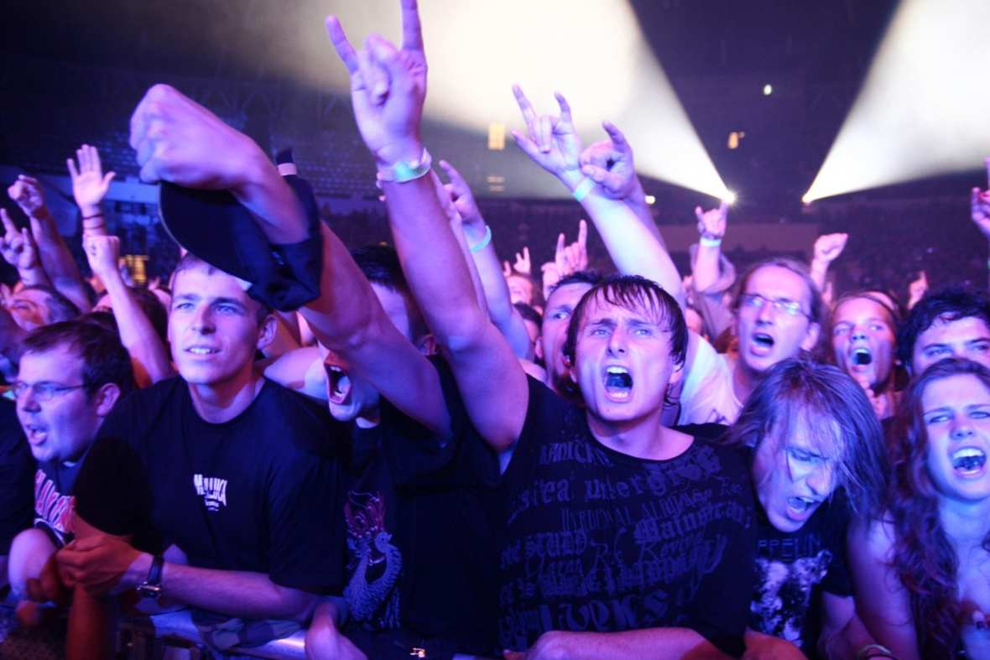
Metal
Numerous studies show that metal workers have a low opinion of themselves. It seems to me that when they listen to this music they express their emotions, which are released by the sharp sounds of electric guitars.

Slide 12
Thank you for your attention

